Slide 1
Team Members
Ahmed Amin
Graduate of the Higher Institute for Administrative Sciences and Information Technology in Kafr El-SheikhGraduate of the Faculty of Management Information Systems (MIS)
Abdelrahman Mohamed
Tanta University computer and information technology faculty
Mohamed Gamal
Menofia National University Computer and Artificial intelligence
Mahmoud Osman
Menofia National University Computer and Artificial intelligence
Mohamed Adel
Gharbiya STEM School - High School Student

Slide 2
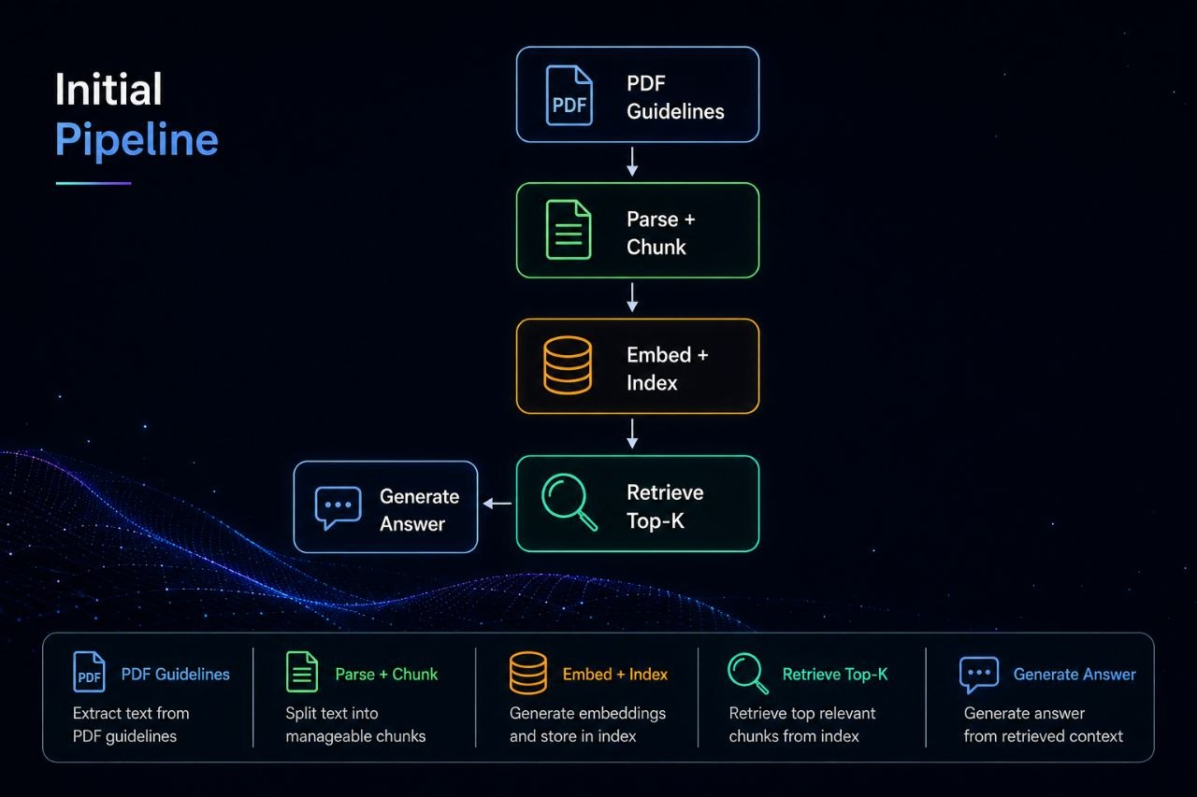

Slide 3
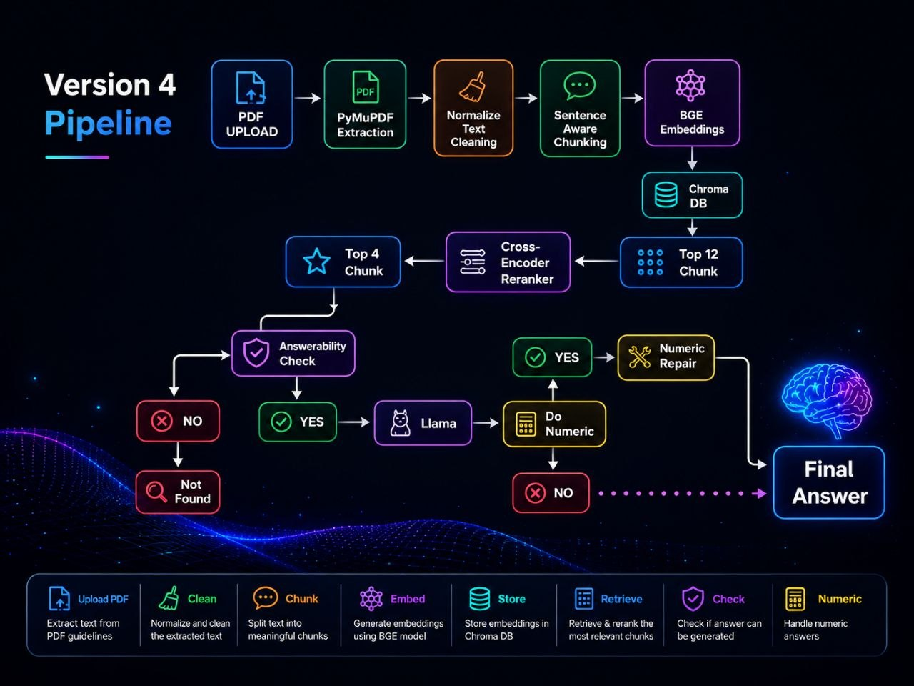
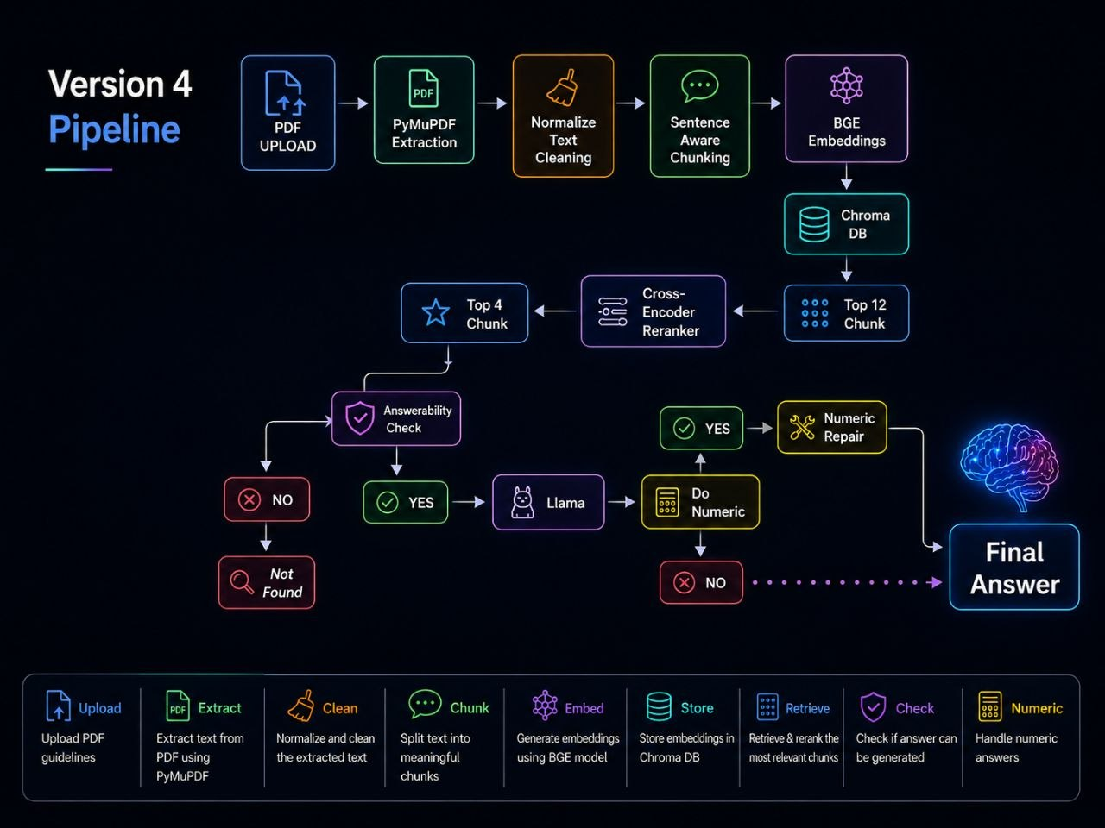

Slide 4
Some details about V4
01
05
Sentence-Aware Chunking
Answerability Check
Because it preserves the context more than Character Based
Ask LLM Do the Context have enough Information to answer Question ?
02
06
BGE Embedding
Numeric Question Detection
BGE Model Faster and better than in Embedding
Next Slide
03
07
Reranker – Cross-Encoder
Numeric Rule - Numeric Repair
Top 12 Chunk from Retrieve ,Then Reranker use Sigmoid to Choice Top 4 Chunk
Next Slide ,Too
04
Lexical Score
Compare between number of words in Question and Chunk
if the number of shared words is large ( High Lexical )

Slide 5
Numeric Question Detection
Is numeric Question ?
If there are words like (Percentage - rate – per 1000 – How many)
Return True
Numeric Rule
Numeric Rule Prompt
Do NOT replace any numerical answer with a text answer
Numeric Repair
If LLM ignored Rule Prompt
Became first answer Draft answer >>> Numeric Repair >>> Repeat Process and make Rule Prompt more specific to answer numeric

Slide 6
Solution for Hallucination & Large Context
Combined Score Chunks
Similarity Threshold 15% >>> Top 12 Chunk
Reranker 75% >>> Top 4 Chunk
Lexical Score 10% >>> Top 4 Chunk (Arranged)
No Hallucination & Narrow Context & Small number of Chunks
Ready to enter in LLM

Slide 7
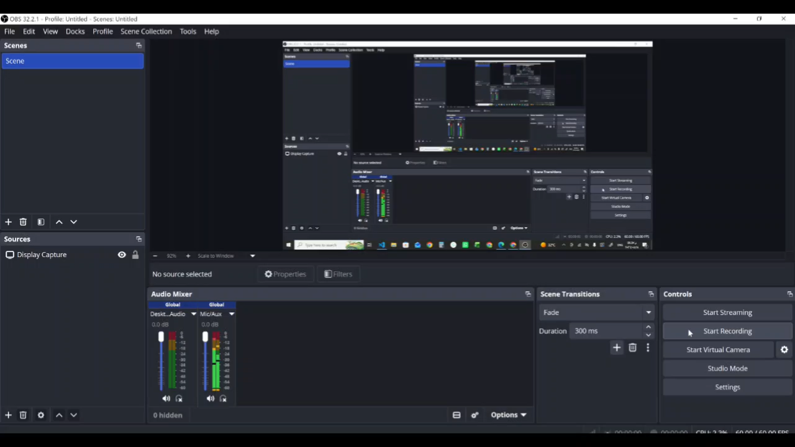

Slide 8
